Slide 1
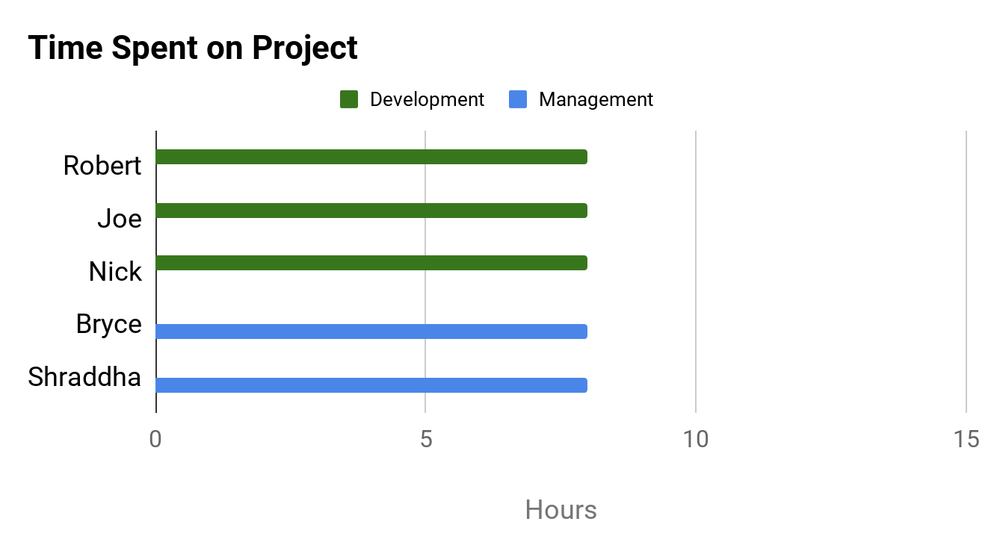
PROJECT DASHBOARD: HAX CMS MICROSERVICE
TEAM: #1
DATE: 5-APR-2020
COMPLETED TASKS
On Target | At Risk | Attention Needed | Not Applicable
PROJECT STATUS
KEY PERFORMANCE INDICATORS
Figured out Docker container commands for Windows
Established use cases and documented on diagram
Saved converted file in specific location
On Target | At Risk | Attention Needed | Not Applicable
Overall: On Target
Time: On Target
CURRENT TASKS
Scope: On Target
Continue development stage
Identify bugs in code
Begin creating test scripts
Test cross-platform use
Cost: No Budget
RISK STATUS
Task | Progress
Development Work
Identify Bugs in Code/Create Tests
On Target | At Risk | Attention Needed | Not Applicable
Risk 1: Time Constraints
60%
ISSUES NEEDING ATTENTION
Risk 2: Lack of Development Support
No issues at this time
Risk 3: GitHub Change Compatibility
15%
Risk 4: Stray from Original Scope
10%
Risk 5: Remote Collaboration

